Slide 1
Software Modeling: Architecture
Dr. Xiaoming Li

Slide 2
Contents
What is software model?
Why modeling?
How to design a software model?
What is software architecture?
How to design an architecture?

Slide 3
1 What is software model?
Software is composed by many programs built from source code.
But how to organize the codes?
Source code
Applicatioin
Software
Tools

Slide 4
1 What is software model?
How to organize the source code?
Poor-organized codes are impossible to compile, debug and read/write by programers
C/C++ use seperate header and source files.
Java use packages and class files.
But they are all low-level ways.
Programmer should do it in application level.
Software modules
Group the source code into different modules
The way how modules are designed is software modeling.

Slide 5
1 What is software model?
Software modules
Have a unique function as a whole, and sub-functions inside, which are tightly coupled.
From the view of the user, the software modules are abstraction of software system activities.
Two ways to design software modules:
Object-Oriented
Top-Down / Traditional / Structure based analysis and design

Slide 6
2 Why modeling the software?
Software can be extremely complex. e.g.
Business software: Information System
Automation software: Robotics, Automatic product line.
Software Engineering's requirements
Make source codes easy to write, read, understood, and debug.

Slide 7
3 How to design a software model
software engineering
OO (object oriented) methods
Structure based analsis and design method

Slide 8
3 How to design a software model
Object-Oriented Methods
OO based requirements analysis
OO based system design
OO based programming
Basic concepts:
Class and Object
Methods and Attributes
Relationship

Slide 9
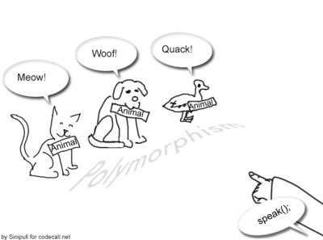
3 How to design a software model
Advanced concepts of OO
Wrap
Overide
Inheritance
Polymorphism
Interface
Virtual Class

Slide 10
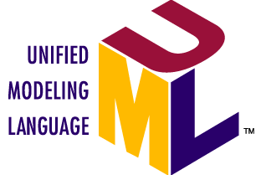
OO modeling
Class Diagram
Sequence Diagram
State Diagram
see "UML" for more details

Slide 11
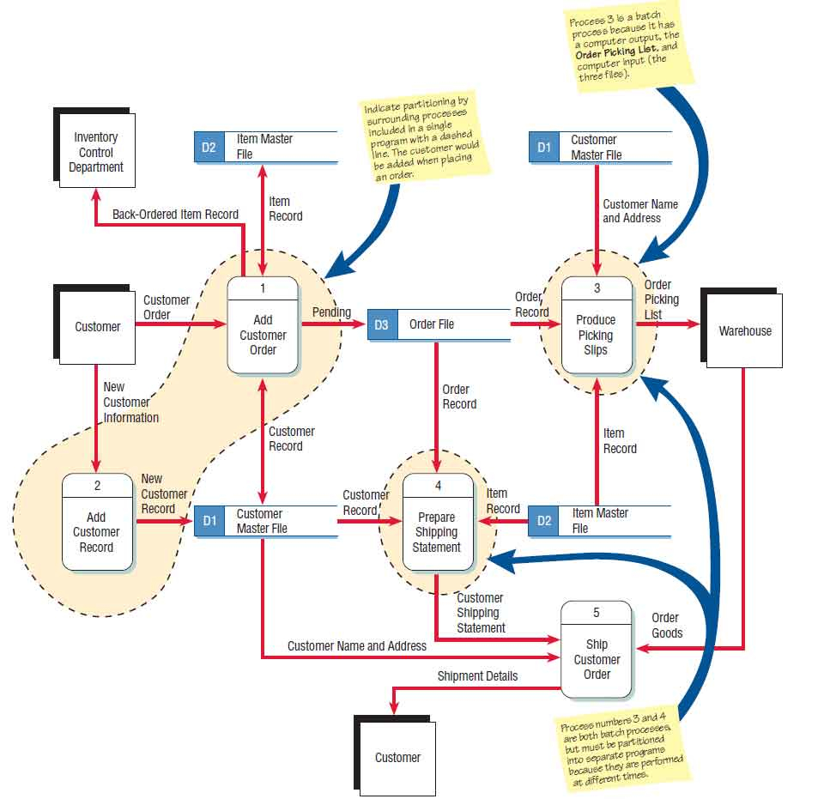
Structure based analysis and Design
Procedure based method
Data structure
Data flow diagram

Slide 12
4 What is software architecture
Software architecture is an implemented model of software
Structure of the software models
Structure has been defined and devided into different modules
Developers need only to implement modules
People who design the architecture is called architect.

Slide 13
5 How to design an Architecture
Method1: Choose from existing framework.
.NET
MFC
MVC
...
Method2: Design from scratch
Principle: High cohesion and low coupling for modules
Feasiblity, extendability, resusability, and easy of use
Experience in programming is very important.

Slide 14
Path to an architect
Programmer
Advanced Programmer
System Analyser
Software Architect

Slide 15
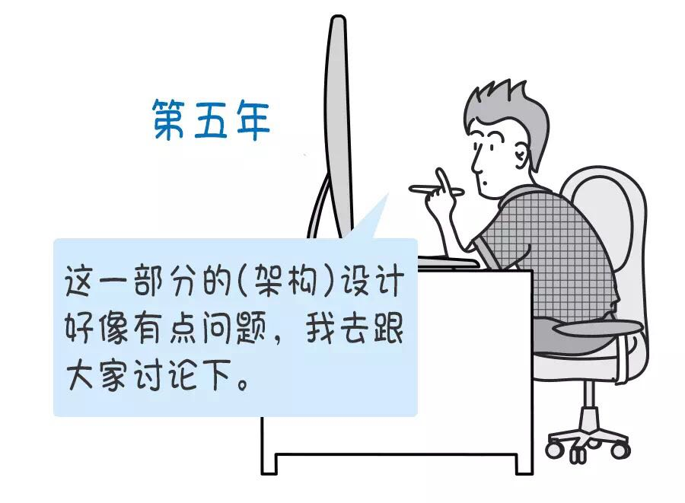


To Mechatronic software developers
Improving through practice
Always keep in mind the ARCHITECTURE.
There may a problem in the architecure and I’ll talk with others
Given codes like this will make the system more relaiable
Can I write code like this?

Slide 16
6 Software frameworks
Software framework is a implemented architecture for some specific application field
Reuse of codes and lower the complexity is the basic idea of software framework
There are many exisiting software frameworks today, such as:
ROS for robotics
Caffe2 for Deep Learning
Spring MVC for web computing
...

Slide 17
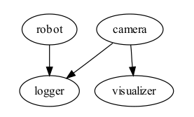

7 Introduction to the ROS
Core ideas about the design of ROS
Peer-to-Peer / Multi-lingual / Tools-based / Thin / Free & Open source
Fundamental Concepts
Nodes / Messages / Topics / Services

Slide 18
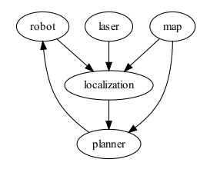
Introduction to the ROS
Other concepts
Package
Logging and Playback
Visualization and Monitoring
Transformations

Slide 19
8 Introduction to the Deep learning framework
Caffee
Nets, Layers, and Blobs: the anatomy of a Caffe model.
Forward / Backward: the essential computations of layered compositional models.
Loss: the task to be learned is defined by the loss.
Solver: the solver coordinates model optimization.
Layer Catalogue: the layer is the fundamental unit of modeling and computation – Caffe’s catalogue includes layers for state-of-the-art models.
Interfaces: command line, Python, and MATLAB Caffe.
Data: how to caffeinate data for model input.

Slide 20
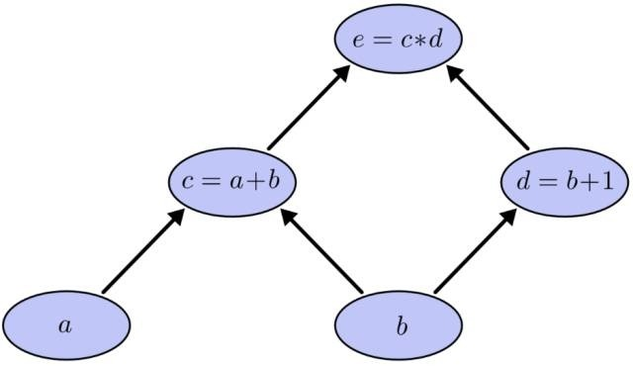
Introduction to the Deep learning framework
Tensorflow
Created by Google, very popular today
Supported nealy by every OS and platform
Conceps:
Graph - define the graph, strucure of deep network
Session - do the calculation

Slide 21
10 Build a framework from scrach
If you cannot find a framework suitable for your application, you can make your own one
Design a software framework is not that difficult as expected
Keep in mind: Abstraction and Re-use
Example: a software framework for mechatronic systems

Slide 22
Example
An XML-Driven Component-Based Software Framework for Mechatronic Applications
A formal way to organize the modules used in the project, usually in the form of components.
An uniform communication mechanism between modules, hiding many technical details from the programmer.
Reuse of modules in the binary level
starting point for beginners

Slide 23
Philosophy of the framework
Ease of use.
Expansibility vs. Extensibility.
Being flexible in architecture.

Slide 24
Framework elements
Component
Communication
Composition / Platform

Slide 25
Component
Structure
Ports – communication
Acts like an agent
Processor – processing

Slide 26
Component
Interface
Need to communicate with platform
Functionality
Embodied by processor

Slide 27
Communication Mechanism
Using ports
output port → input port
Data being transferred has a life period
Prevent component using the stale data
Allow multiple, layered inputs
Port is extensible
E.g. a port support networking communication

Slide 28
Principle for composition
Platform
integrate the components into a whole
manage the components
A complete program by itself
Wire
A communication cable for components
Can be dynamically changed

Slide 29
XML-Driven Model
Using XML to describe how to integrate the components into a function-complete application
Modules
Wires

Slide 30
Example XML file

Slide 31
Implementation of the framework

Slide 32
Some experiments we have done
Tele-robotic application
Autonomous mobile robot

Slide 33
Tele-robotic application

Slide 34
Tele-robotic application

Slide 35
Autonomous application

Slide 36
Summarize
A framework can really minimize the complexity for building complex software, and lower the risk of failure in building such system
No longer need to start the whole project from scratch, since we have already had such a good base.

